Slide 1

UCL Department of Economics
MSc Economics
Open-door day
February 2024

Slide 2
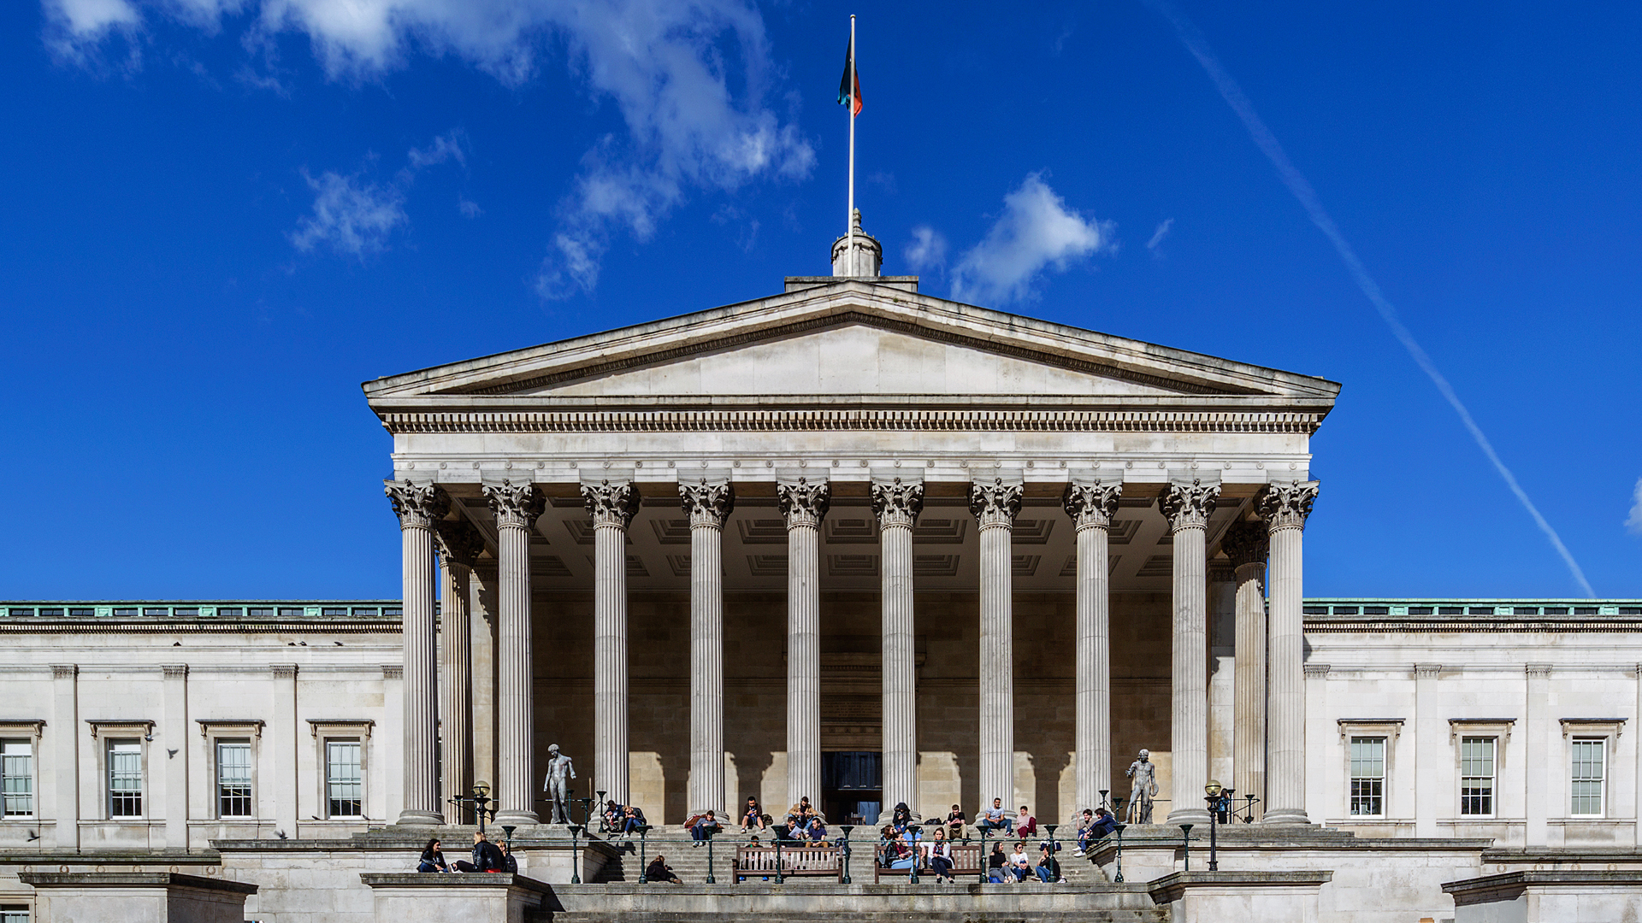
Welcome!

Slide 3
Today
Why do MSc Economics at UCL?
Studies
Community
Admissions

Slide 4
Why study Economics at UCL?
UCL MSc Economics is a top programme
UCL Economics is one of the best research departments in the UK and worldwide
Every year we get an amazing cohort of students who are passionate about Economics
We offer a large variety of courses in all fields of Economics
The training is rigorous, with a very strong quantitative component

Slide 5
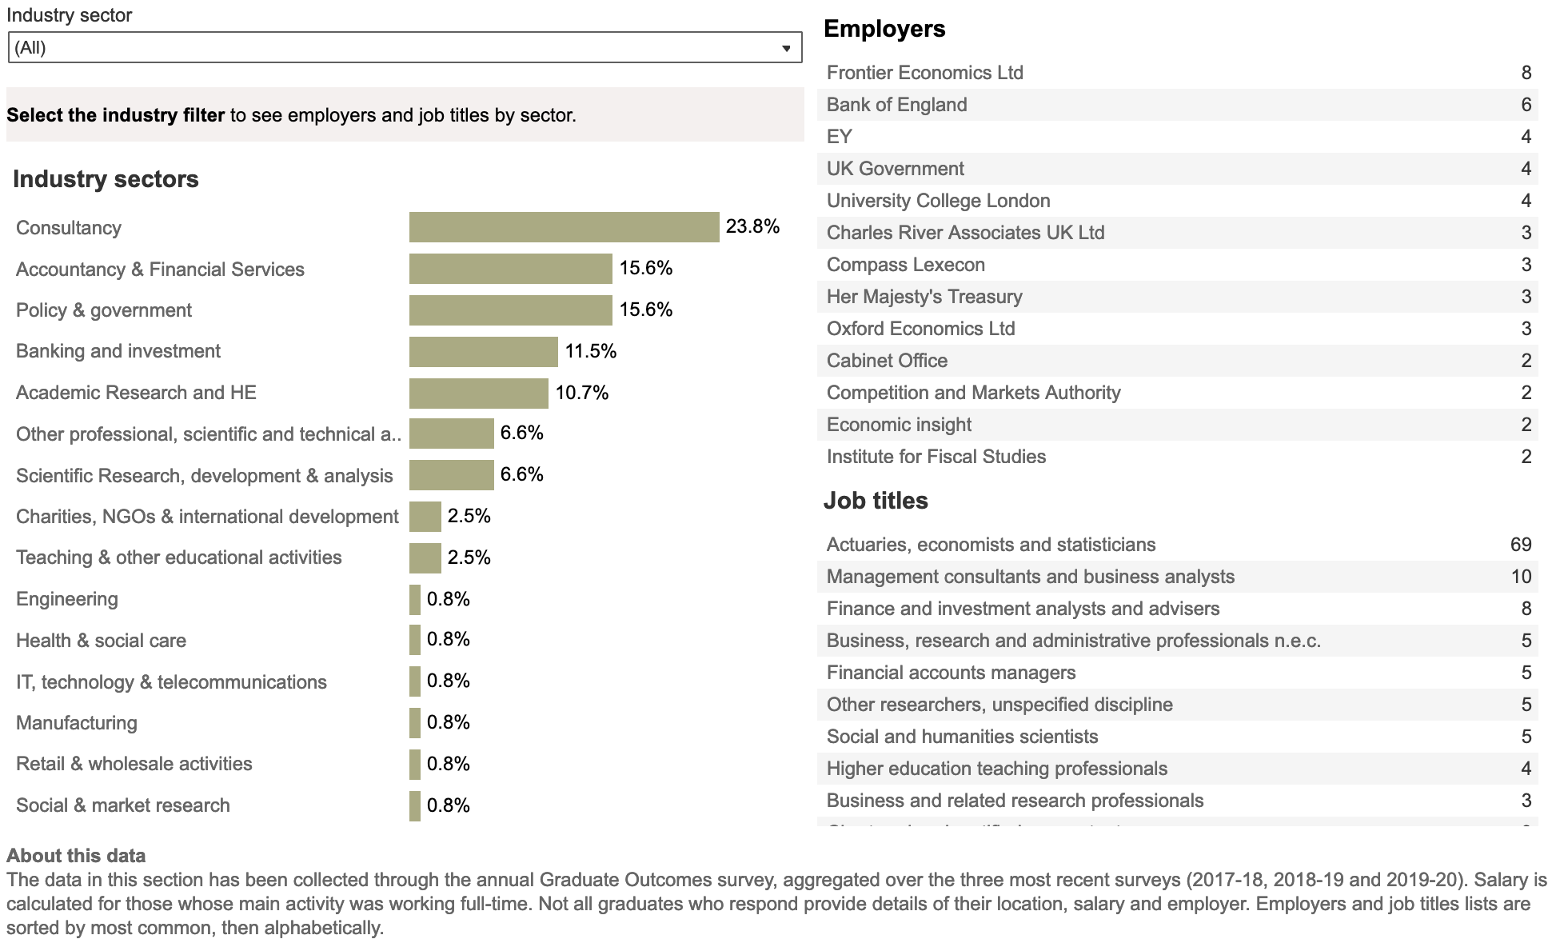
Graduate destinations

Slide 6
UCL MRes/MPhil/PhD Economics Programme
There is an established track to transition from MSc Economics to the Economics PhD programme
We offer support and advice for students applying for PhD studies in the UK and overseas

Slide 7

1. Studies

Slide 8
Academic year
Summer 2024: Math and Stats (mandatory)
Throughout the year: Research methods
Term 1: core courses (25/09-15/12)
Term 2: option courses (08/01-22/03)
Term 3: exams (22/04-07/06)
Summer 2025: Dissertation (08/06-10/09)

Slide 9
Term 1: core courses
Microeconomics, Macroeconomics, Econometrics
Teaching each week consists of:
Preparatory materials on Moodle
Lectures (on campus, 3hr a week, recorded)
Tutorials (on campus, small groups, 1hr a week)
Group problem sets
This trio of modules is a foundation for optional modules in term 2

Slide 10
Term 2: optional courses
LIST A (applied)
Public Microeconomics
Topics in Labour Economics
Topics in Money and Finance
Health Economics
Empirical Industrial Organisation
Behavioural Economics
International Trade
Economics of Development
Macroeconomic Policy
International Political Economy
Programme Evaluation for Users
Environmental Economics: Principles and Policy
Data Science Theory
Machine Learning in Economics
LIST B (advanced core)
Advanced Macroeconomic Theory
Time Series Econometrics
Advanced Microeconomic Theory
Advanced Microeconometrics

Slide 11
Dissertation
Students get a unique opportunity to work on their own research project
Members of the Economics department offer support and supervision—you get to work with the world leading researchers
The dissertation allows you to try your newly acquired skills in action

Slide 12
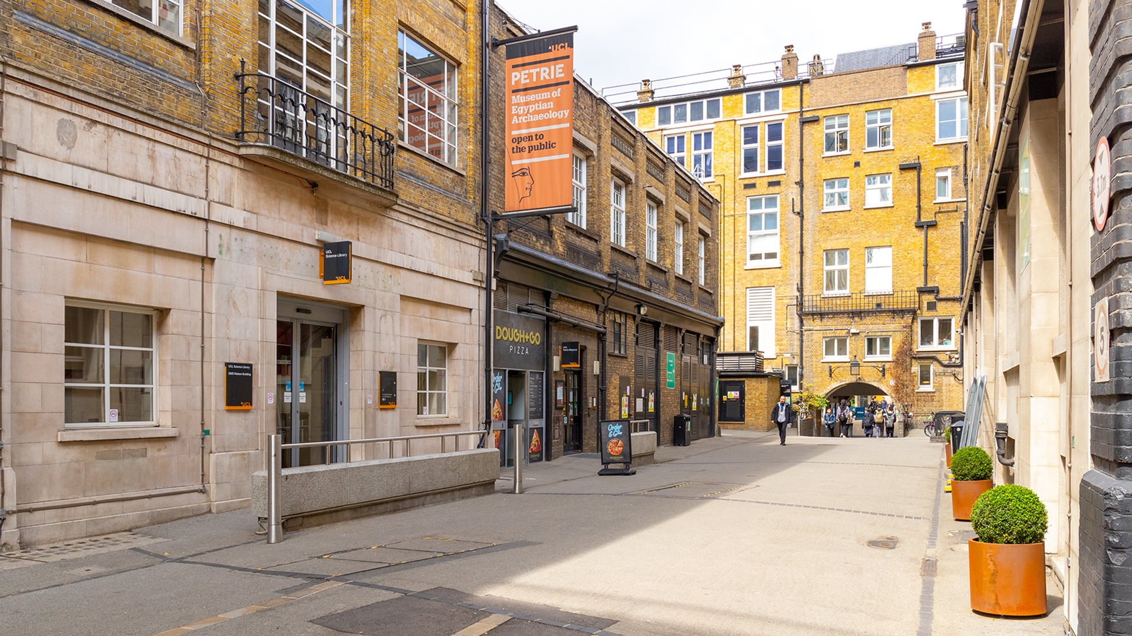
2. Community

Slide 13
Students’ roles
Student representatives
A bridge between the department and the students
Brief informal, regular meetings with the programme director
One formal committee meeting per term
Social committee
In charge of organising social events
Liaise with the Economist’s Society (http://www.economistssociety.org)

Slide 14
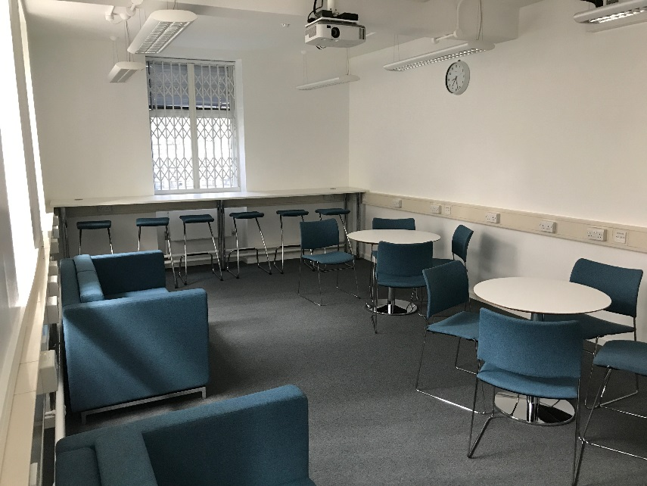
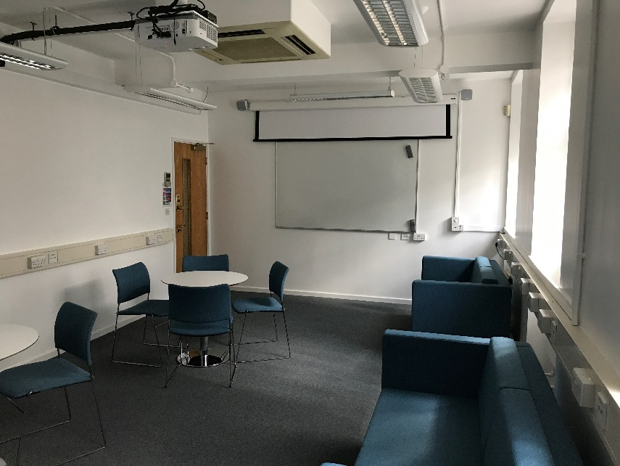
MSc common room

Slide 15
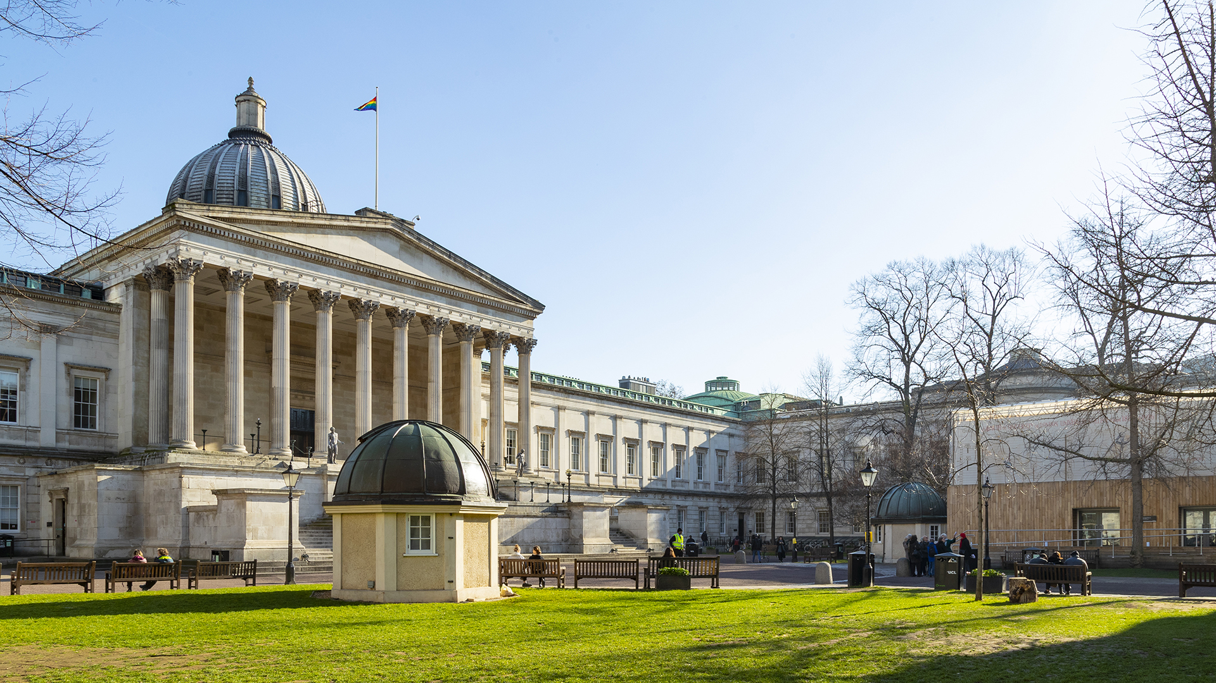
3. Admission criteria

Slide 16
UCL students
2.1 degree; above median
Econ, Math and Stats modules. Here are some examples:
SSEES: Applied Econometrics, European Macroeconomics, and Topics in Microeconomics...
BA Philosophy and Economics: Quantitative Economics and Econometrics , Microeconomics, Macroeconomic Theory and Policy
BSc Management Science: Business Economics (I and II), Mathematics (I, II and III), Data Analytics (I and II)
PPE: Econ, Micro, Macro and Intro to Maths for Econ
For questions, contact economics.msc.admissions@ucl.ac.uk

Slide 17

UCL Department of Economics
Questions?

